Slide 1
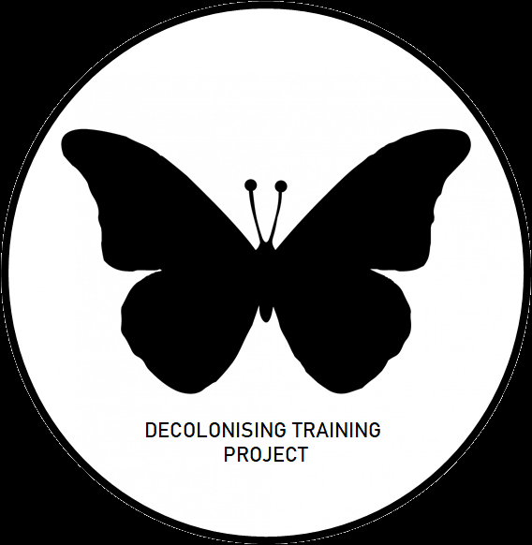

Behind the Black Butterfly: An interactive project walkthrough to share insights on how to make your researcher training more inclusive
Neelam Wright and Mike Rose
Vitae Conference 26th September 2023

Slide 2
The ‘DecolT’ Team & Contributors (images redacted)
Staff partners: Neelam Wright, Micheal Rose, Emma Francis, Rana Marrington, Nadya Yakovchuk, Mark Whelan
Trainers: Karen Gravett, Carlette Norwood, Alfred Thumser, Catherine Batson
Student consultants: Shantel Lynch (PGR) and Meghan Simmons (VP voice)
Surrey Black Scholars Team: Emily Williams, Jay Rowe, Janet Ramdeo
Doctoral college team wider support: Shijia Yu, Alex Pavey, Kate Gleeson, Beau Bell

Slide 3

The ‘DecolT’ Team & Contributors
12 paid BAME PGR partners for 3 months co-creation work with staff partners:
Careers workshop
Examinations workshop
Supervisor relationship workshop
Writing workshop
8 paid BAME PGR consultants work for 2 hours with our Director of Doctoral college:
New supervisor training course

Slide 4
Objectives of this workshop
You feel more confident and motivated to embed inclusive & co-creation practices within your own institutions
See examples of good practice for race-related PGR/staff partnership and co-creation projects
Easy-to-apply tips on how to 'decolonise' training to work with ethnic minority PGRs
You will have participated in meaningful exploration of change agency, anti-racism and allyship

Slide 5
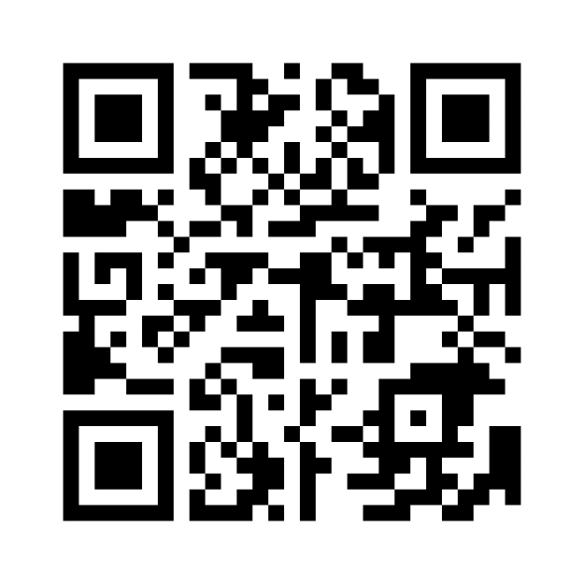
Let’s understand our collective baseline on the topic
Please use your phone to fill in our mentimeter poll
Go towww.menti.com
Enter the code3214 6152

Slide 6
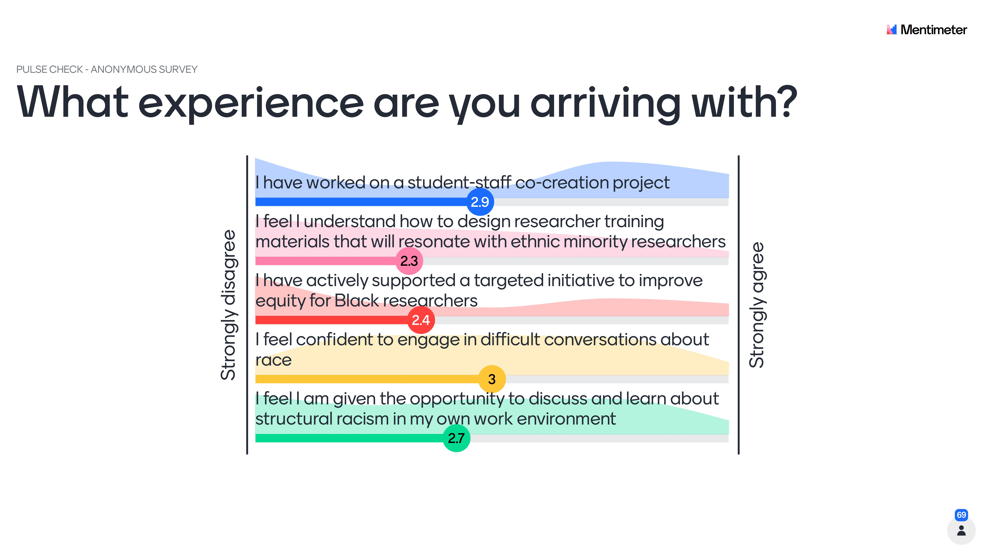
69 respondents from different HEIs completed this live poll at the Vitae researcher development conference 2023 workshop: 'Behind the Black Butterfly: An interactive project walkthrough to share insights on how to make your researcher training more inclusive'

Slide 7
Ice breaker: What is ‘decoloniality’?
In your groups, produce a single sentence or short paragraph that explains what you think it means to ‘decolonise’ something
You only have 5 minutes!
If you wish, you can discuss this specifically in the context of training / teaching
If you aren’t sure, give it your best guess - all answers are of value ☺

Slide 8
Collective definitions of 'Decolonisation' From an activity involving the Researcher Development Community (Vitae conference 'Behind the Black Butterfly' workshop 2023 – 96 attendees)
Interrogating "why we do what we do" - and consider their theoretical origins.​
Decentering – Challenging the norm/gold standard.
Looking through different lenses.
Process of acknowledging, reflecting and actively including non-White-Western-northern views and "facts" and contributions.
Bringing in under-represented voices and diverse perspectives ("colonising" in reverse) whilst making space for those missed voices by challenging existing structures and narratives.
A process of opening conversations and investigating practices, to empower a multiplicity of cultures and knowledges.
Institutions as representatives of the canon.​

Slide 9
Collective definitions of 'Decolonisation' From an activity involving the Researcher Development Community (Vitae conference 'Behind the Black Butterfly' workshop 2023 – 96 attendees)
Setting up a process or creating an environment which accounts for diverse, alternative, individualised perspectives, contexts which represent local environments, experiences, reasons. Considering alternatives (to Western) approaches.
Considering the individual​.
Challenging the idea that works created by white/Europeans represent the paragon of academic excellence.
Questioning the 'universal subject/knowledge'.
There's an element of individuality – people can share similar experiences but also often have very different stories/feelings to share and have different needs.
It's about raising awareness about colonialism, that it has an influence on our lives today and actions we can take for positive change​.
Challenging assumptions.
Rectifying injustices that developed because of our colonial past.

Slide 10
But why ‘decolonisation’?
Links with the broader HE ‘decolonising the curriculum agenda’
‘Inclusive’ is less provocative, but it can dilute the agenda…
Honouring a term that is meaningful and empowering for many
Decolonisation methods and approaches:
Enable self-critique
Encourage the deconstruction and disruption of existing knowledge
Help us to interrogate institutional norms, structures of power and privilege
Create a space for criticality in the learning space
Focus on race (decentring whiteness)
Can support other under-represented groups and protected characteristics
Information on the term 'Decolonisation' in the context of researcher development, explaining how it was used for the Vitae 2023 conference workshop about this project

Slide 11
Emerging literature and related concepts
Eurocentrism
Hidden curriculum,
grand narratives
Borderlands and counterspaces (Masta; Guerin 2021)
Decentring Whiteness
Anti-Racism, allyship, Social justice
The myth of neutrality (Brookfield, 2003)
Co-creation &
Student Partnerships
Change Agents
(Guerin, 2021)
Cultural intelligence; the Bennett scale
Unconscious bias
Diversifying the canon
Repressive Tolerance
(Brookfield, 2019)
Courageous conversations
Inclusive pedagogy /
curriculum
Student voice
Institutional racism and race inequalities
Deficit approach
Equity & Equality

Slide 12
Structure of the DecolT project
Training 6 staff partners
(researcher development trainers)
Recruit 1 student consultant and set up project steering group
Recruit 12 student partners
(plus 8 additional student consultants)
Train student partners
Student and staff partners workshop
(introductions, context, objectives)
Partnership groups meet regularly for 3 months
List of recommendations for training workshop changes produced by each group
End of project evaluations (student focus groups, staff reflection session)
Implement changes to workshops and relaunch new versions (inform all partners)
Thank yous and goodbyes
Dissemination to wider sector (update all partners to demonstrate reach and impact of our work)
Publication output (organisational development guidance; inclusive training playbook)

Slide 13
Recruitment tips
We received a flurry of applications at a time where recruitment numbers for interventions were low
Values-led instead of competencies-led
Essential criteria: be mindful of structural inequalities
Remove formalness from application form and job advert
Diverse selection panel to counter unconscious bias
Info packs for transparency
A ‘wellbeing menu’ to acknowledge for emotional impact and differences

Slide 14
Pair group discussion: Partnerships
Why would you want to set up a student-staff partnership project?
What do you think is the ‘added value’ of doing student-staff partnership work?
If you wanted to partner with students, who might you approach in your own institution?

Slide 15
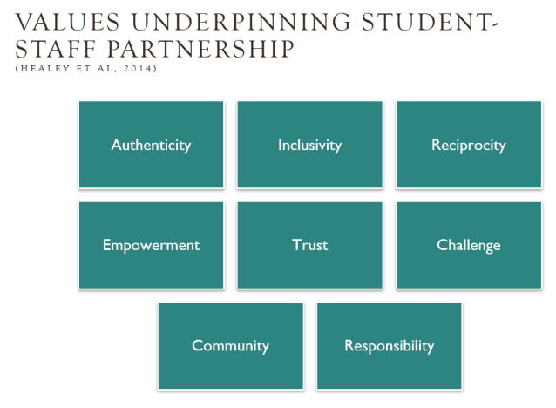
Values and Principles
The updated Advance HE Framework identifies nine values (Healey et al 2019a) which underpin successful student engagement through partnership: authenticity, honesty, inclusivity, reciprocity, empowerment, trust, courage, plurality, and responsibility.
Understanding what we mean by these values (and not making any assumptions that they mean the same things to each other as well as what they mean to PGRs), was an important starting point.

Slide 16
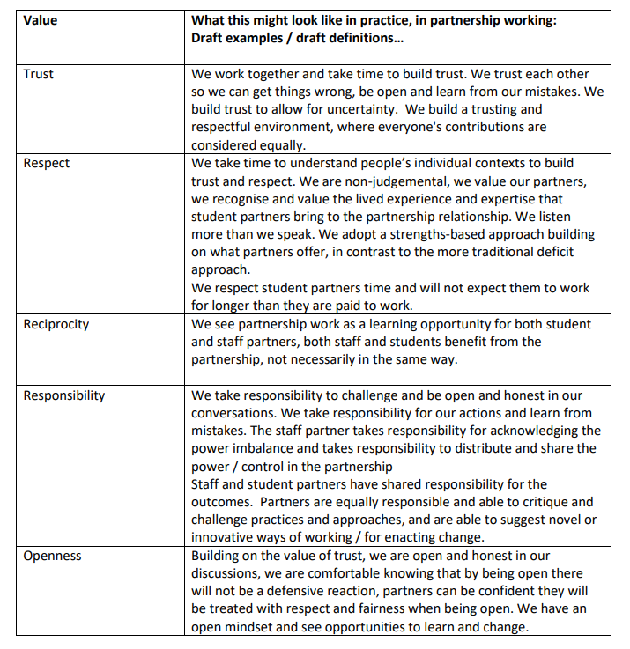

Slide 17
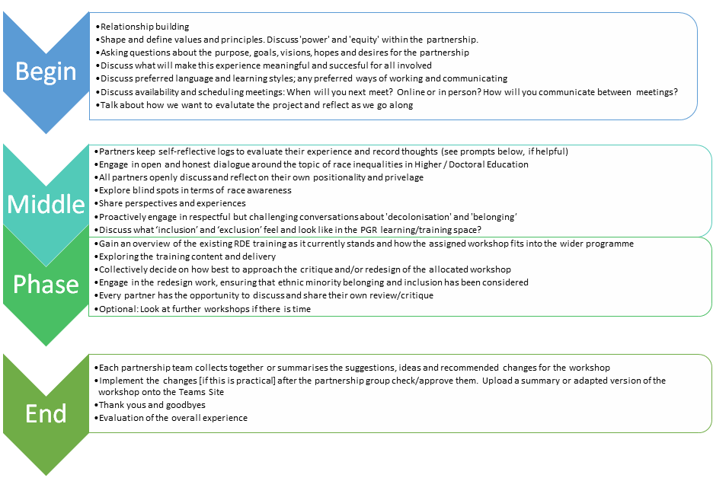

Slide 18
Student Partnership theory
Read:
Bovill, C. (2020), ‘Co-creation in Learning and Teaching: The Case For a Whole-class Approach in Higher Education’
Gravett, K. Kinchin, I. M. and Winstone, N. E. (2019). ‘More than customers’: Conceptions of students as partners held by students, staff, and institutional leaders. Studies in Higher Education.
Gravett, K., Yakovchuk, N. and Kinchin, I.M. (Eds.) (2020) Enhancing student-centred teaching in higher education: The landscape of student-staff partnerships. Cham, Switzerland, Palgrave Macmillan.
Mercer-Mapstone, L., M. Islam and T. Reid (2021) ‘Are We Just Engaging ‘The Usual Suspects’? Challenges in and Practical Strategies for Supporting Equity and Diversity in Student–Staff Partnership Initiatives’, Teaching in Higher Education, 26 (2), 227-245.
Tom Lowe (Ed) (2023) Advancing Student Engagement in Higher Education: Reflection, Critique and Challenge
Consult:
Karen Gravett
(partnership theory)
k.gravett@surrey.ac.uk
Maisha Islam
(EDI and student voice)
m.islam@soton.ac.uk
Attend:
The Advanced HE Inclusive Student Engagement and Partnership workshop

Slide 19
Advice from our Student Union (VP voice)
Important conditions for an effective and equitable staff-student partnership:
Create an informal bond
De-professionalise your manner; avoid overly structured conversations (chat vs. meeting)
Make it explicit: "I care about you" (empathy)
“Criticism can be hard for staff. They can take offence…”. How can you best deal with this?
Create a 'culture of feedback' (to make it easier for the student to be open and honest)

Slide 20
Independent reflection task
What might you need to consider, if the student partners you work with are from Black, Asian Minority Ethnic backgrounds?
Challenge: You can use the intersectionality wheel to select a particular combination of characteristics.
What might you need to consider, if the student partners you were working with were from these protected characteristics or under-represented backgrounds?
Prompts
Further training or reading you might need
Assumptions and language around these characteristics
What if you make a mistake? How would you resolve it?
Power dynamics
How would you articulate your positionality?
If you don’t expect to have any such participants, what might that tell you?

Slide 21
Useful Things for Decolonising Training
The Kingston University Inclusive curriculum approach was a helpful practical framework to start with:
Co-creation as a way of decolonising the curriculum
Understanding privilege/diversity amongst students
Use demographic data on our current cohort to shape our annual programme of training
Enable students to see themselves and their backgrounds reflected in the curriculum
Develop literacies amongst staff
Try to avoid making decisions based on what majority want
Equip students with the skills to positively work in a global and diverse world

Slide 22
Nathalis Wamba, Decolonizing the curriculum (2021)
I suggest that we begin with the decolonization of ourselves. To the proponents of decolonization, let's start with the process of decolonizing our own minds. This requires us to challenge, interrogate and purge ourselves of the servitude knowledge that we have acquired in western or westernized institutions and seek deep down and acknowledge our complicity with what gives us status.
So how did the DecolT trainers try to do this?

Slide 23
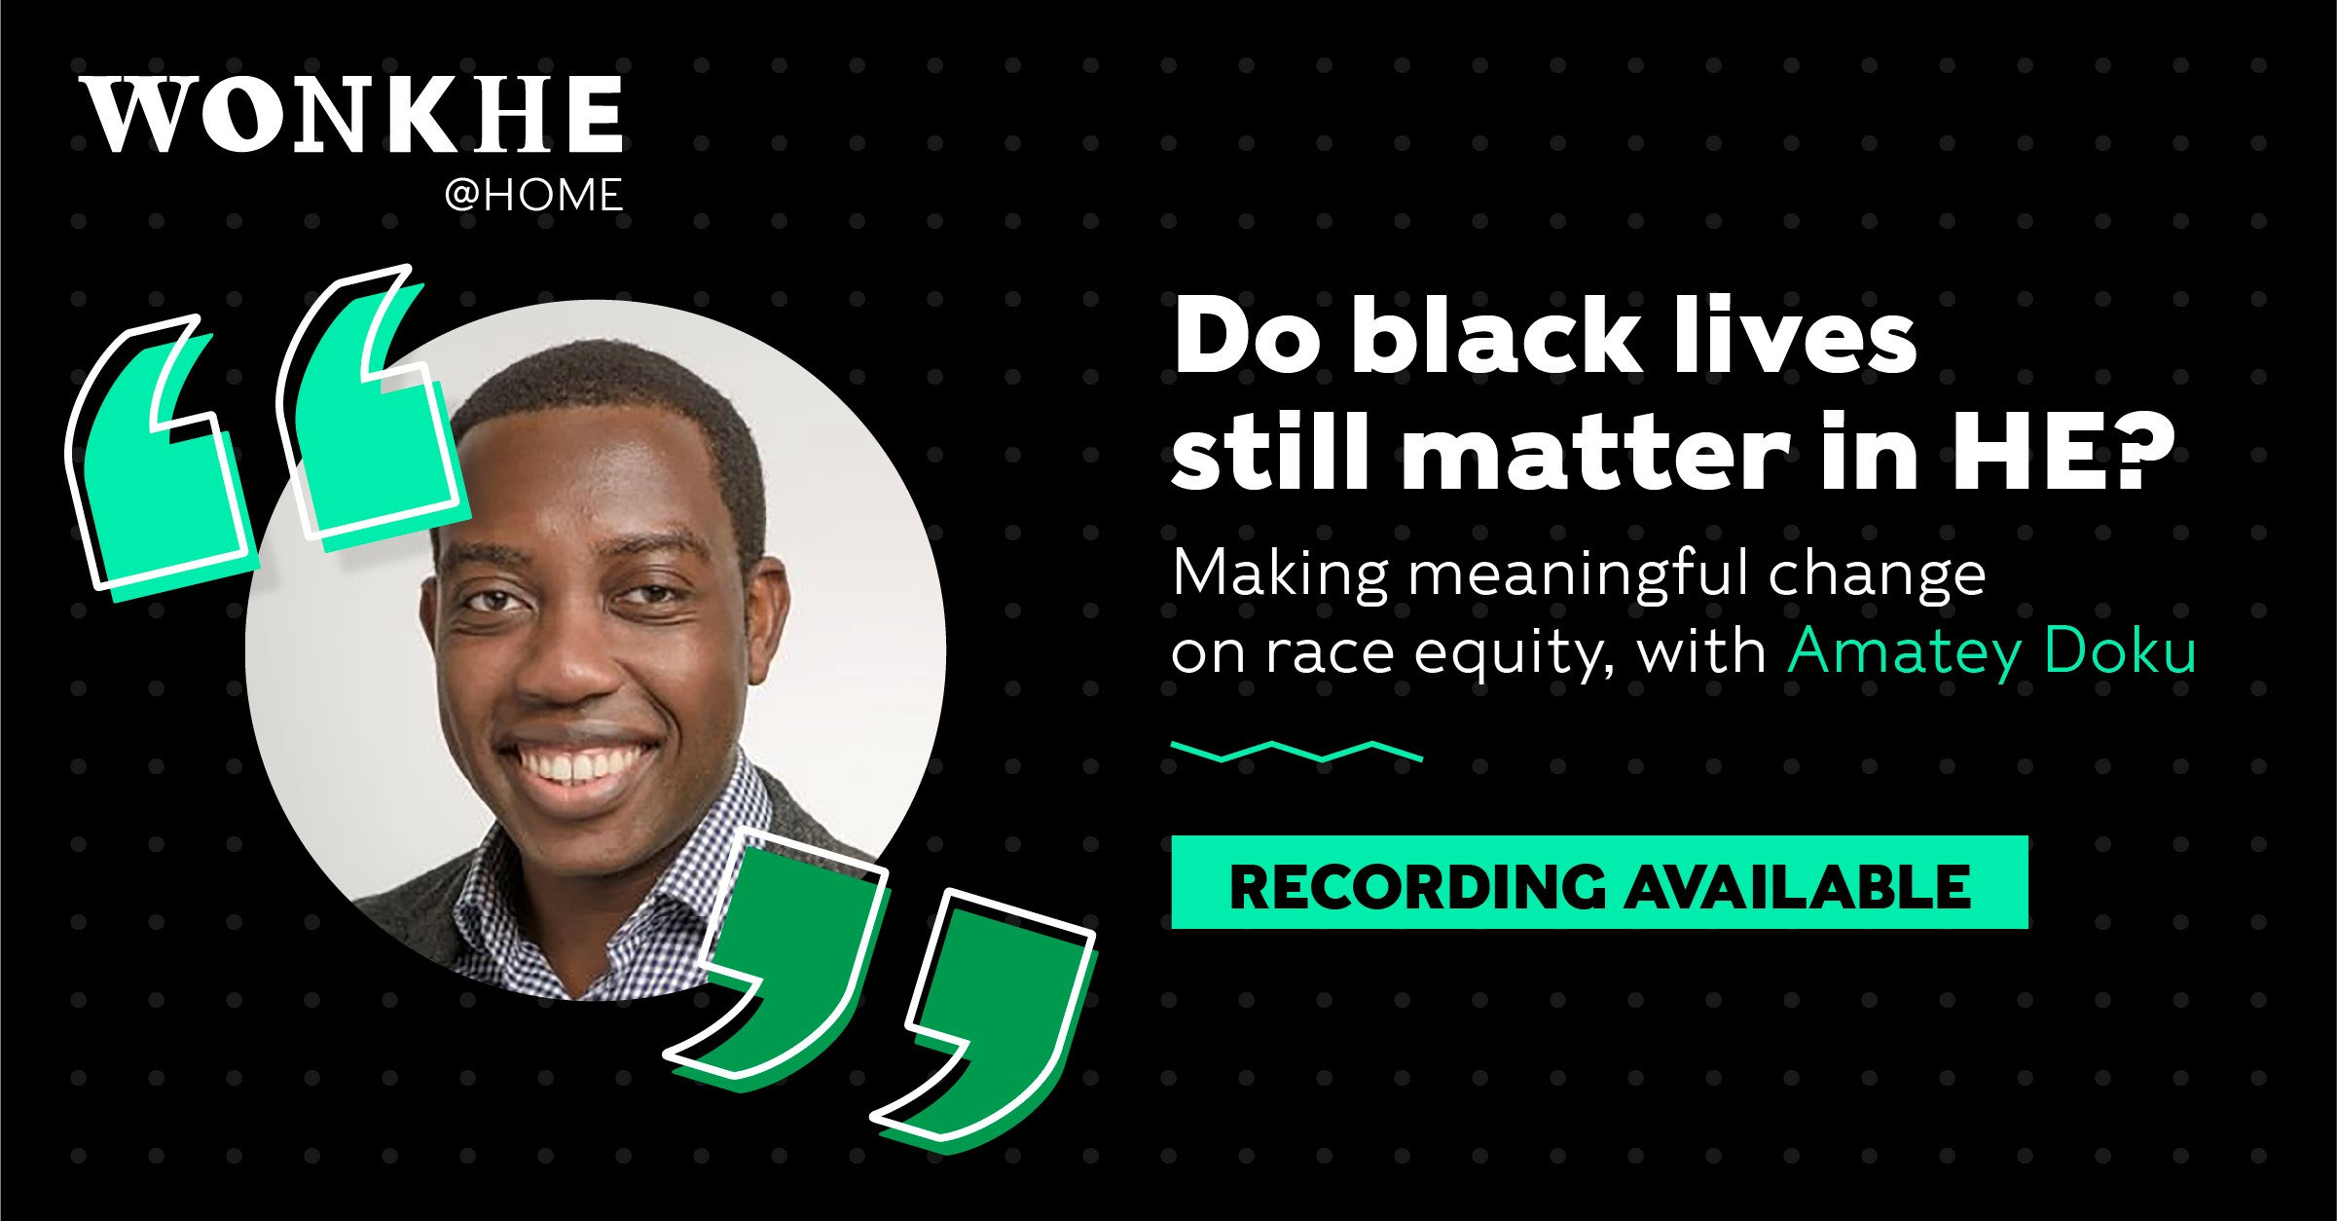

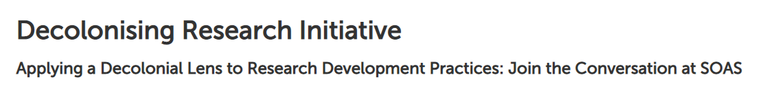





Developing cultural awareness

Slide 24

Practicing challenging conversation
This needs to be learnt and requires practice
Being open to receiving critical feedback - it hurts but it gets easier!
Putting ourselves in 'brave spaces’ rather than ‘safe spaces’

Slide 25

Self-reflective diaries
Neelam used a self-reflective diary to reflect on what was happening in her own training and elsewhere in the HE environment.
Staff partners found keeping diaries a valuable method for psychologically safe and honest self-critique.
Student partners felt this was useful for holding on to their personal voice and perspectives.

Slide 26
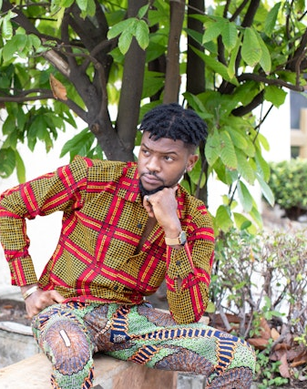
General tips on how to ‘Decolonise’
How might a researcher training workshop reinforce white-centric thinking?
How might it exclude an ethnic minority person?

Slide 27
Observations in the training room
British context humour and in-jokes
Inaccessible references, metaphors and sayings
Avoiding people with foreign names or thick accents
Bias in the case studies
Exclusionary delivery styles
Assumed cultural and historical knowledge
Whose voice is elevated in the room?

Slide 28
A useful checklist to try out
Can I identify some alternative canons of knowledge that might have been marginalised or dismissed here?
Is there a range of voices and perspectives represented?
Who is being presented here as a role models for success? Are they also from ethnic minority backgrounds?
Can I re-conceptualise this to reflect wider global and historical perspectives?
Do I need to diversify the reading list and citations?
Have I normalised diversity and difference, or is it an exception/tokenistic?
Am I opening safe channels for learners to ask questions and provide feedback on the education they receive?
How can I create counter-spaces within this learning space?
Have I considered linguistic and cultural differences enough?
Do the topics/examples/case studies that I use reflect the demographics of the cohort; and am I actively ready to change them from one year to the next?
Have I removed any potentially outdated, stereotyped or offensive content; do I need to call out prejudice or bias in the content?
Am I embedding activities that allow students to draw on their own heritage and culture to develop group learning and understanding?
Reverse Education: Is there an opportunity here for students to teach the teachers?

Slide 29
Watch our PGR partners in action!
A short video of three of our PGR partners critiquing the content for the PGR ‘Managing your Supervisory relationship’ workshop.
Recommendations made were around:
setting expectations
power dynamics
culture clash
conflict resolution
bias around preferred modes of assertiveness

Slide 30
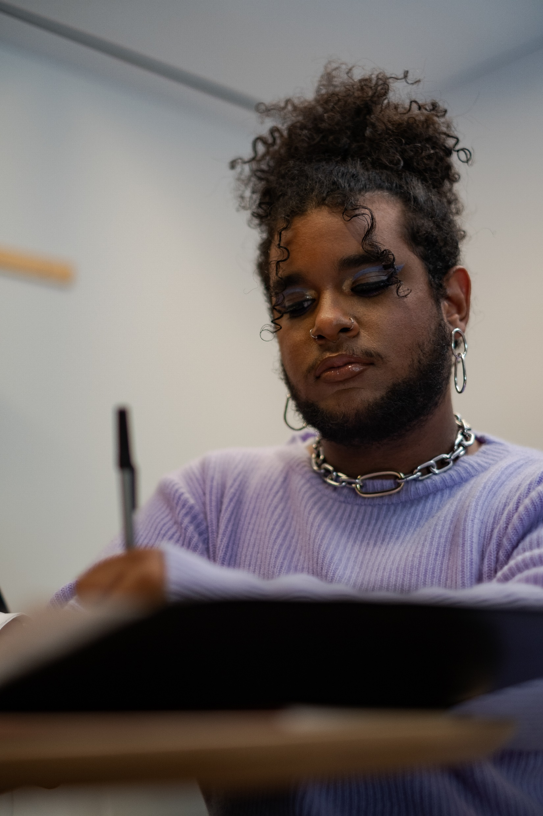
Training changes: Writing
Critiquing norms
Writing examples from a range of disciplines and cultural backgrounds
Discussing cultural differences in referencing styles
Discussing inequalities in publishing
Belonging in the workshop – be yourself and relaxed (ice breaker)
Endorsing the freedom to develop your own voice
A new framing (‘positionality’) statement when we talk about the academic writing style requirements.
“Academic writing is nobody’s mother tongue”
- Staff partner

Slide 31
Training changes: Writing
Positionality statement
There is no one uniform or correct ‘academic writing style’
The ‘academic writing style’ we commonly refer to has developed as a set of norms arising primarily from the scientific knowledge production and dissemination practices in the ‘Global North’, and some of these practices are changing
The focus of our teaching is on how to write to meet the expectations of the University and the specific requirements for passing the PhD confirmation at Surrey
There is variation in the ‘academic writing style’ and conventions across the disciplines
“Academic writing is nobody’s mother tongue”
- Staff partner

Slide 32


Training changes: Careers
1. More explicit reference to discrimination in academia and industry / commerce & challenges potentially faced by researchers of colour
acknowledging those challenges (validation)
sharing strategies to survive and thrive
ensuring sources of support are evident
2. More explicit reference to challenges faced by international researchers
3. A wellbeing lens on careers – stress anxiety, pressures, emotional – based on lived experience examples at Surrey
4. Incorporating more data on BAME professions
5. Thinking about language barriers and avoiding idiomatic phrases
6. Being a sounding board rather than expert
“What I wanted to take from the DecolT project was how it could be useful in changing the industry” – Student partner “I often refer to competition /discrimination, and support available for disadvantaged groups, but have hesitated sometimes to make too much of this as not wanting to make people feel uncomfortable. However, I was reassured that acknowledging these challenges is helpful as it validates experience” – Staff partner

Slide 33

Training changes: Examination
Creation of ‘voice of experience’ materials from examined PGRs, ensuring a diversity of voices
More exploration of social and cultural conventions in the viva setting, making sure we do not assume everyone will be equally familiar or confident
Providing some history of the PhD viva to give it context. We more explicitly acknowledge the social constructs around this form of examination
How to speak ‘academically’ in a viva. More explicit thinking around ‘codes of acceptance’
Its not about pretending to be someone else: more coaching and mock viva opportunities to help get the balance right
Discussing defensiveness vs aggressiveness (based on common microaggressions)
Exploring sensitivities around responding critically to figures of authority
“There are inequalities reinforced by structured approaches to working; we kept going back to the point that the confirmation has to be written like that”
- Student partner

Slide 34

Training changes: Supervisors
“I was never taught to challenge teachers. I was taught to listen and obey them. All of a sudden, I was told to call my teacher by their first name and challenge things you don’t agree with”
- Student Partner
Develop skills for cultural empathy and CQ
Enforce clarifying of expectations (on both sides)
Address confirmation/geographical bias and majority think
Individualism vs collectivism: understand how the latter is an asset to research, not a handicap
Understand how imposter syndrome and race/ethnicity intersect
Understand the academic wheel of privilege – offer appropriate and diverse role models
Use case studies in their training that reflect genuine BAME lived experiences at the University

Slide 35
During the process: Student partners
I feel it has taught me how to.. mak[e] decisions while having a strong standpoint, come up with original ideas and shape ideas with constructive criticism
I have discovered the extent of work which can be done to make workshops more inclusive… I don’t think if those [PRES] surveys are showing the real issues that PGRs are having. I really hope projects like this initiative would continue to make changes.
I had reserved myself to the position that my lived experience had little to add to the complex problems of institutional culture. Since undertaking this project, I do feel more ‘relevant’ to the conversation on diversity and inclusion within academia. It’s the first time in my four years at Surrey that I feel I truly have a voice.
[the experience] has deepened my sense of belonging to a wider community.
I am very glad to be a part of this project, sitting with like minded people to freely discuss things I have never felt safe enough to share.
At the start of this project, I had a lot of thoughts on how genuine this project was, whether it was just a tick box exercise. But when I compare this to other UK universities I have been to, this has been the most I have personally seen, which I guess is positive.
I feel that being a student partner has been a meaningful process that has allowed me to dwell more on and articulate my sense of belonging at Surrey. It has opened a Pandora’s box of thoughts and feelings about my identity and lived experiences… the most liberating and rewarding part of the project is being provided a platform to speak without a filter to create a safe space for my voice.
This project feels different as the power dynamics between partners are equitable and each partner in our group has something valuable to contribute.
Personally, I wasn't sure of what to expect trying to decolonise curriculum with member of staff, but I must admit that so far, the opportunity to share our own lived experience and identify gaps is very satisfying… This project has reinforced the fact that it is not enough to identify problems, providing practical solutions and readiness to push for change goes a long way
…I feel this has been and empowering and enlightening experience. It is great to see that such a topic has been made a priority at the University and I am hoping this will be the catalyst for further improvements.

Slide 36
Evaluation: Staff partners
The value is in listening to PGR stories and the live circumstances… it’s a gift
[It taught me to be aware of] the trainers own limitations
[There was] difficulty taking bits out to make room [in the training content]
It helps all… [it is] applicable across a variety of contexts
the staff training… needed more discussion and more on the system
[I thought about my style of] delivery rather than just content
It’s been a mind-opening experience
I had not appreciated how my own endorsement of ‘Black exceptionalism’ could harm the experience of our Black PGRs
[I learnt to develop] agile content, reshaped based on who is coming [to the session]
[It was a] mechanism of self-reflection

Slide 37
Evaluation: Student partners
It will take a long time to have an impact. Inequality is ingrained with so many layers.
Surrey is so insular, and this could limit the sway that the DC could have over academics… It’s all about power dynamics. People are unwilling to relinquish power in a way that might threaten their egos and positions.
I’m optimistic that the feedback we gave will be implemented
I was considering an academic career… This is why I ended up on the DecolT project. I questioned why I would want to be in this kind of institution.
It’s good to see that staff in my department are recognising (DecolT) and telling PGRs about it. That touches my heart, a little bit…
people outside of the DC are still belonging the way they do… It’s not changing too much. We are taking very small steps.
Because of the colour of my skin, I spend a lot of time dealing with trivial things rather than focusing on my research… This is why I got involved with the DecolT process…
DecolT can inform the way we teach.

Slide 38
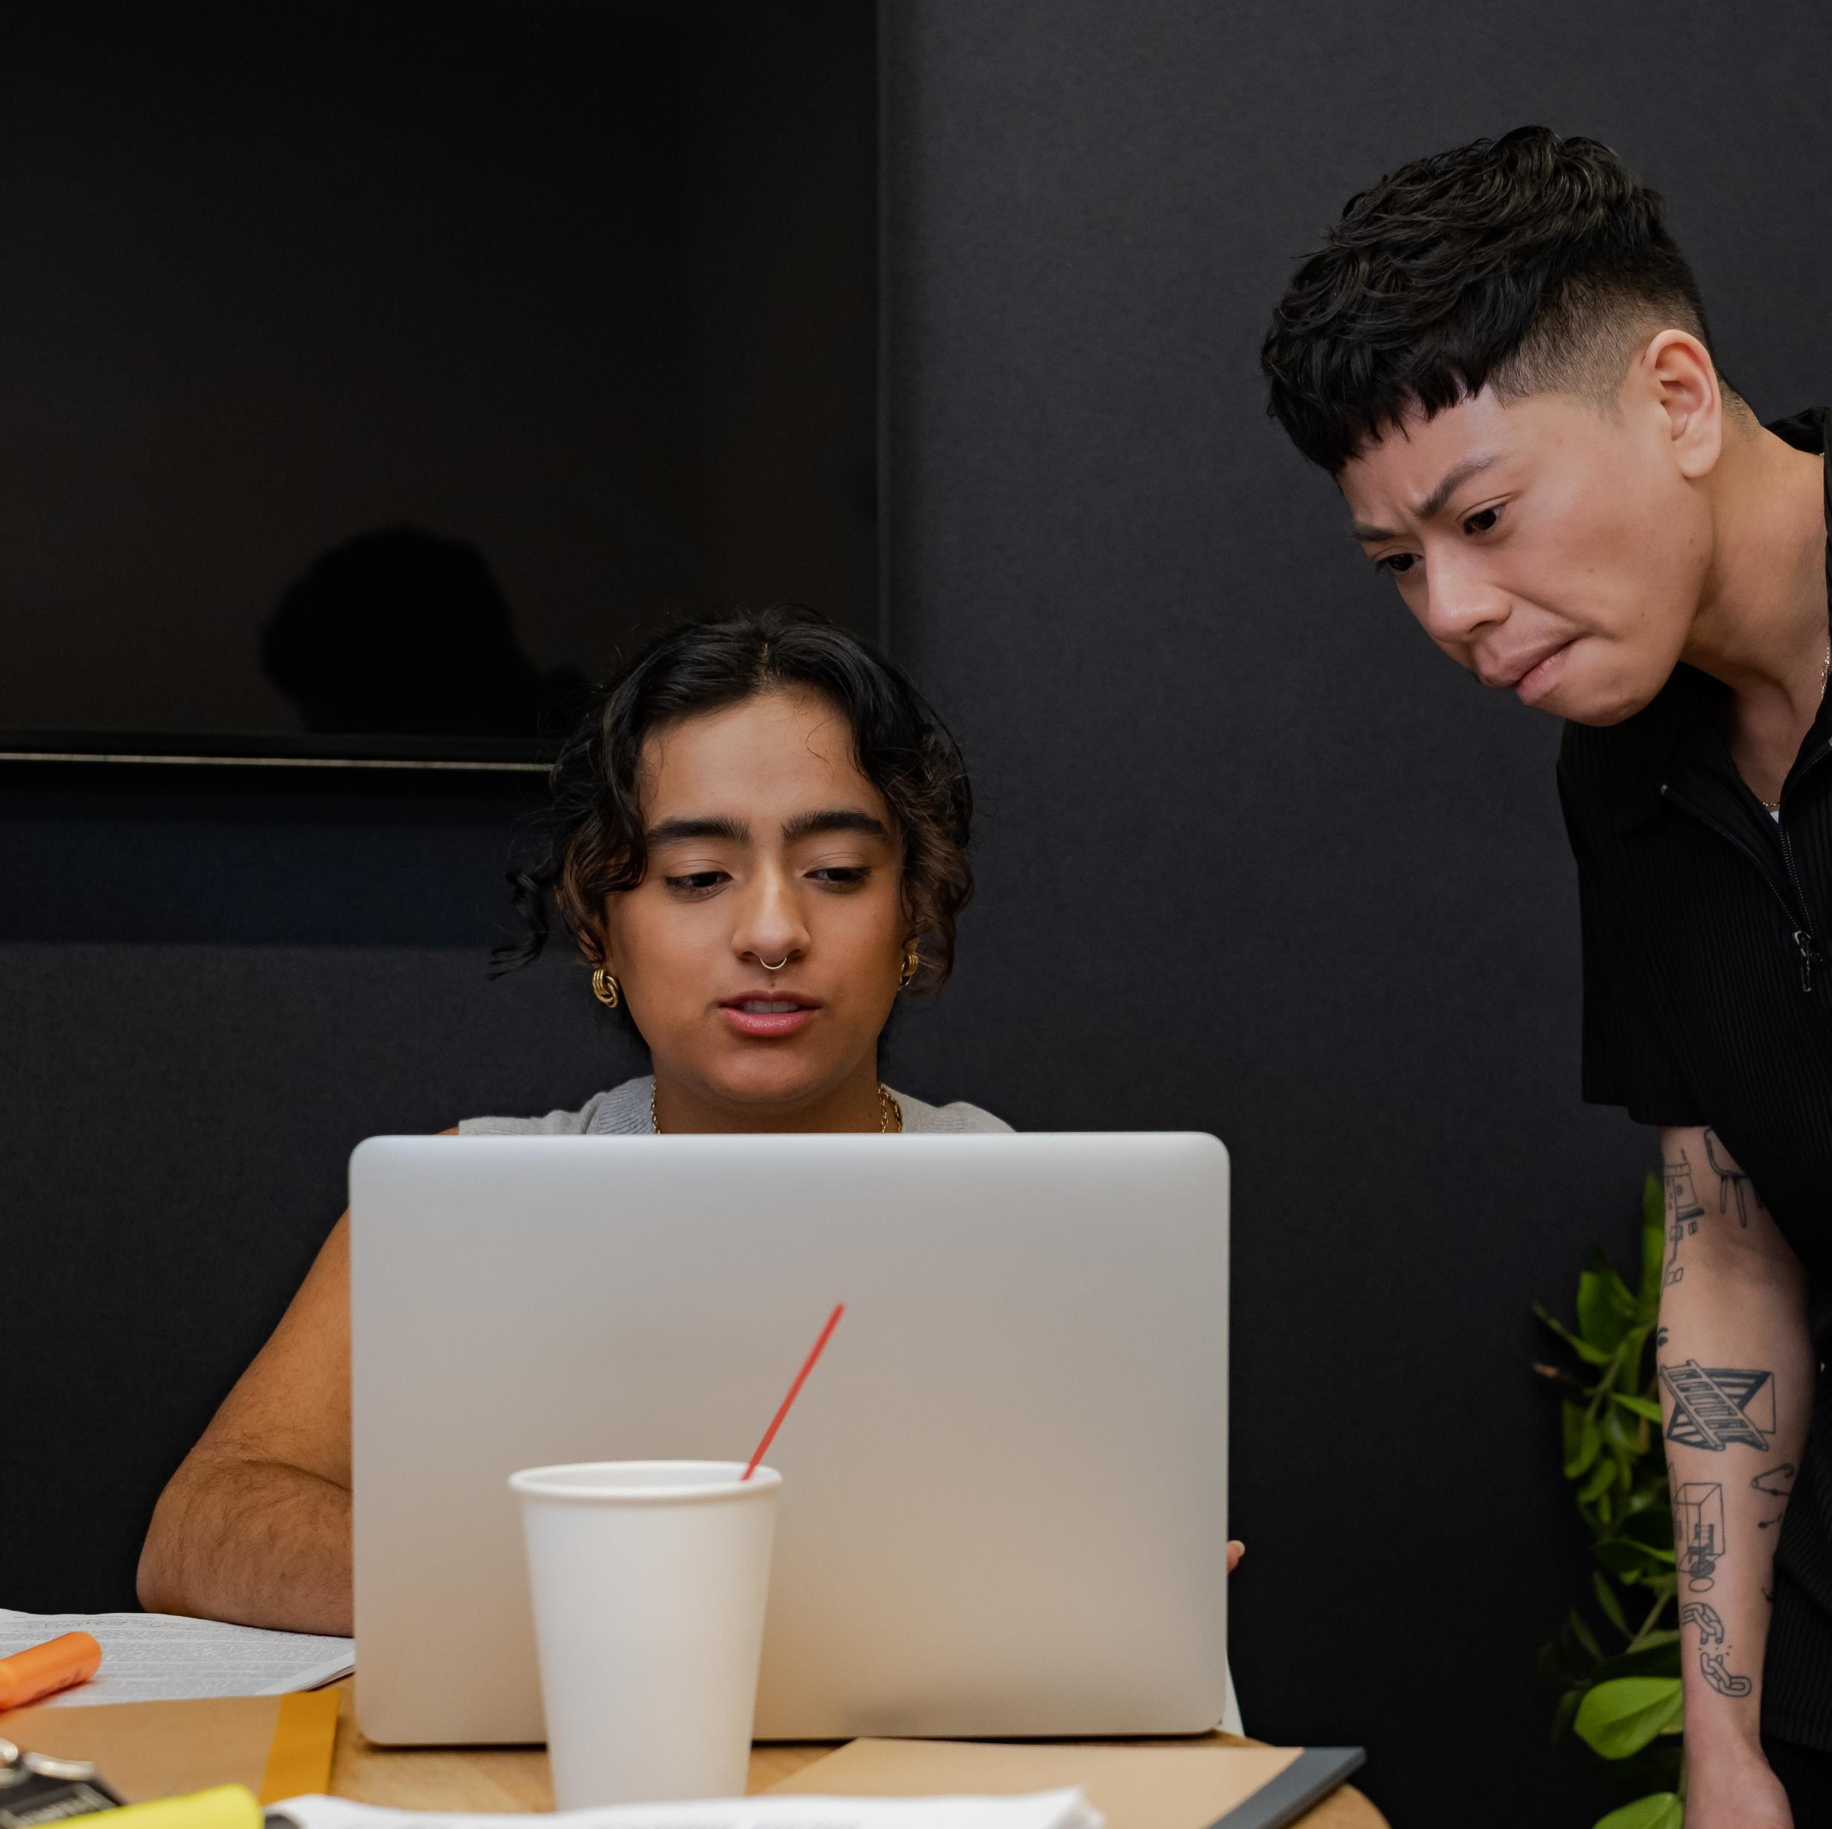
Tips for future Partnerships
Allow people to make mistakes – if its working, it will happen!
Pay your PGRs if you can
“Be prepared to be changed…”
Be careful not to take on the anxieties. It is emotional and at times uncomfortable work, for both students and staff
Some sector wide issues are outside of our circle of influence. Have realistic expectations of yourselves as you can't solve everything

Slide 39
Objectives of this workshop
You feel more confident and motivated to embed inclusive & co-creation practices within your own institutions
You come away with examples of good practice for race-related PGR/staff partnership and co-creation projects
You leave with some easy-to-apply tips on how to 'decolonise' training so it better supports ethnic minority PGRs
You will feel that you participated in a meaningful and safe exploration of change agency, anti-racism and allyship in researcher development

Slide 40
Post it! Give us your Feedback
In what way did you find this workshop helpful?
What are you going to do now, as a result of attending this workshop?
The feedback we received from this activity demonstrates genuine impact on researcher developer motivation and engagement.
The full selection of feedback we received from this session is available here.
Note: these are unfortunately a PDF so please contact Neelam if you cannot read them. She will be happy to assist.

Slide 41
Thank you and good luck! From Mike, Neelam and the 2022 RDP team at Surrey
“Can a mere researcher developer do anything to help challenge institutional racism? As it turns out, yes they can”
- Staff partner

Slide 42
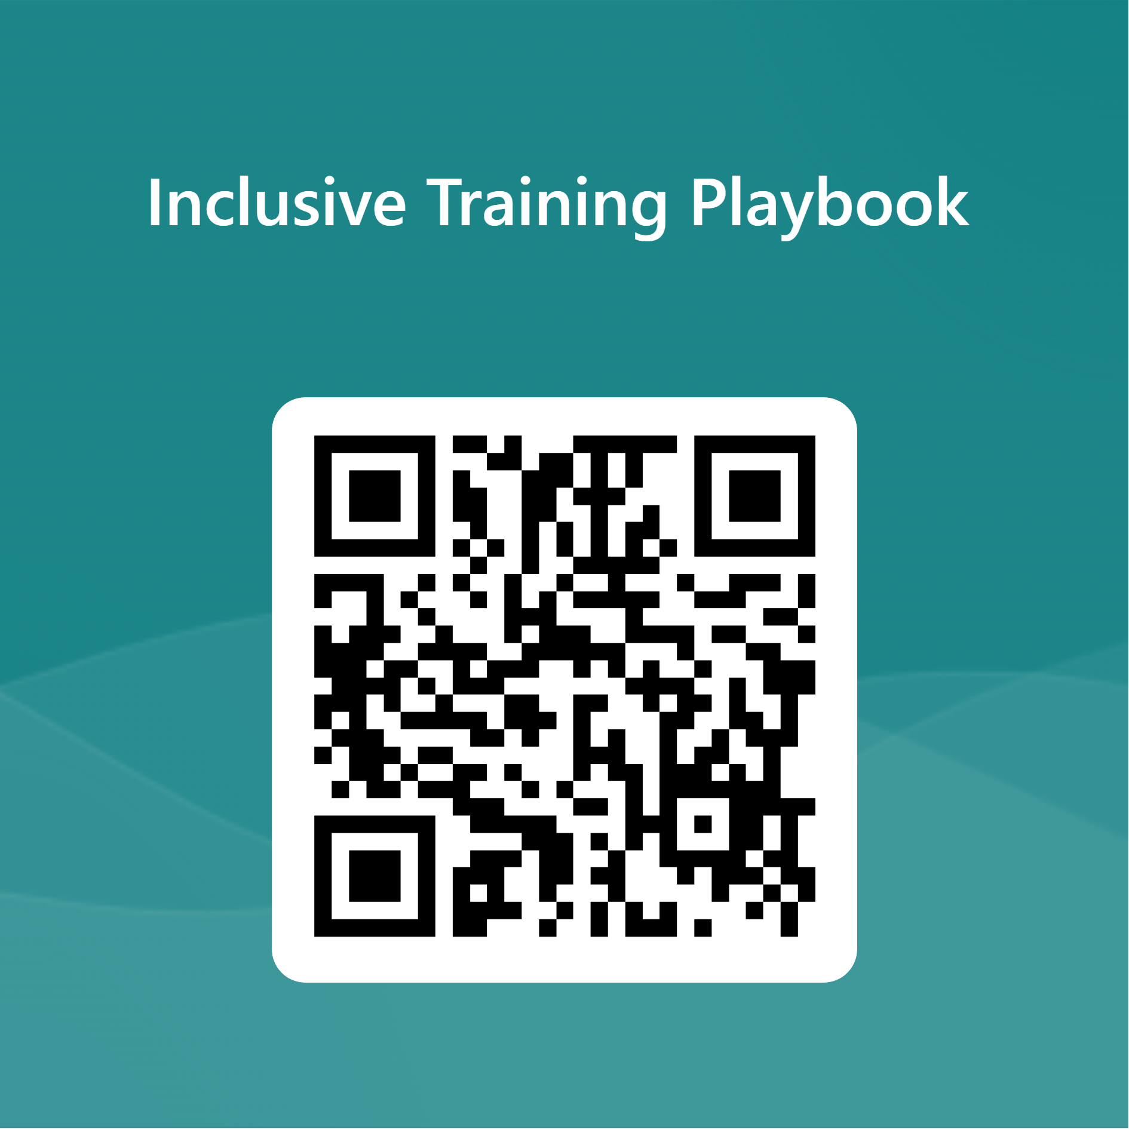
Coming soon: The Inclusive Training playbook
The book will offer a simple and handy selection of hints and tips on how to design training for researchers in an inclusive way.
For the under-represented, by the under-represented!
Contributors still wanted from neurodivergent, disabled, LGBTQI+, ethnic minority or other disadvantaged backgrounds.
Register your interest and watch this space!

Slide 43
Further Reading and resources
Bovill, C. (2020), ‘Co-creation in Learning and Teaching: The Case For a Whole-class Approach in Higher Education’
Gravett, K. Kinchin, I. M. and Winstone, N. E. (2019). ‘More than customers’: Conceptions of students as partners held by students, staff, and institutional leaders. Studies in Higher Education.
Gravett, K., Yakovchuk, N. and Kinchin, I.M. (Eds.) (2020) Enhancing student-centred teaching in higher education: The landscape of student-staff partnerships. Cham, Switzerland, Palgrave Macmillan.
Mercer-Mapstone, L., M. Islam and T. Reid (2021) ‘Are We Just Engaging ‘The Usual Suspects’? Challenges in and Practical Strategies for Supporting Equity and Diversity in Student–Staff Partnership Initiatives’, Teaching in Higher Education, 26 (2), 227-245.
Tom Lowe (Ed) (2023) Advancing Student Engagement in Higher Education: Reflection, Critique and Challenge
Decolonising Education: From Theory to Practice - Decolonial Theory Course (futurelearn.com)
The Advanced HE Inclusive Student Engagement and Partnership workshop
Intersectionality wheel
Equality, Diversity, and Inclusion Resources - University of Surrey, Doctoral College (padlet.com)
The Gender Spectrum Collection: Stock Photos Beyond the Binary (vice.com)

Slide 44
Contacts for further guidance
Neelam Wright n.wright@soton.ac.uk
Academic Developer Expertise: Decolonising Training, BAME PGRs, EDI Micheal Rose mr2441@bath.ac.uk Researcher Developer Expertise: Viva Examinations, Academic publishing Emma Francis e.francis@surrey.ac.uk Careers Consultant / Trainer (ECRs, PGRs) Expertise: Careers, Allyship Rana Marrington r.marrington@surrey.ac.uk Careers Consultant / Trainer (ECRs, PGRs) Expertise: Careers, International students
Nadya Yakovchuk n.yakovchuk@surrey.ac.uk Senior Teaching Fellow Expertise: Academic writing Catherine Batson c.batson@surrey.ac.uk Associate Director, Student Experience Expertise: Decolonising reading lists, student curation Emily Williams emily.d.williams@kcl.ac.uk Professor in EDI (PI for Surrey Black Scholars to 2023) Expertise: Race inequalities in HE, Black British in Academia Janet Ramdeo j.ramdeo@surrey.ac.uk Lecturer in Higher Education (PI for Surrey Black Scholars) Expertise: Inclusive Curriculum, Black women in HE

Slide 45
Project materials
The free open access latest version of this resource pack, along with further materials from the Decolonising Training Project can be found here:
https://github.com/superbfluous/decolonising-training
Videos of Mike Rose’s reflections from the workshop can be found here:
https://clipchamp.com/watch/45vViNGVpnL

